Slide 1
CSS3 Cascading Style Sheets
Adding Style to your Pages

Slide 2
Browser Default Styling
The same html file may look different when viewed on different browsers.
Some tags are supported, some aren’t
Browsers may have different default styles
In general, default looks are plain.

Slide 3

Adding Style
As styling tags were phased out of html, styling was done with style attribute
Violated separation of content/style

Slide 4
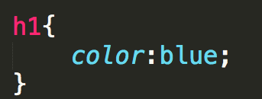
Cascading Style Sheet
CSS defined generic rules that can apply to multiple elements
selector {
property: value;
}

Slide 5
Rule Syntax
Brackets and semicolons are very important
This is where a good editor can make a BIG difference

Slide 6
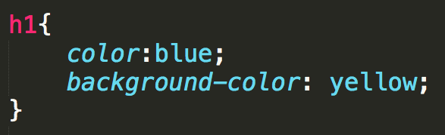

Multiple Properties

Slide 7
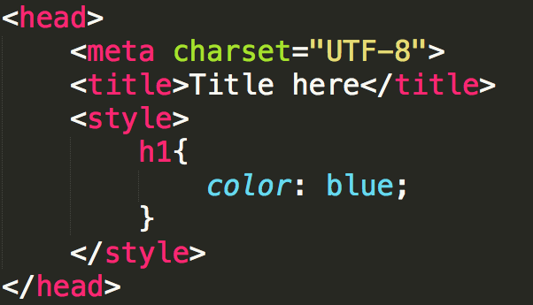
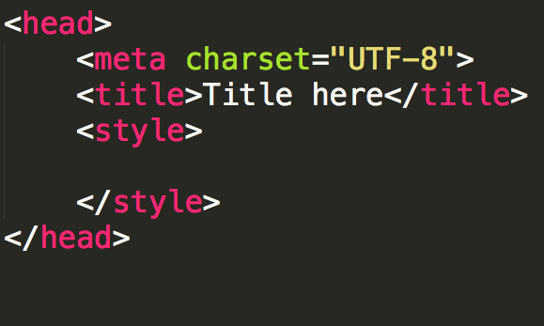
Internal Style Sheet
Styling is defined within <head>
Rules are defined within <style>
Styles are applied to all elements in that file
Don’t forget to close the style tag!!

Slide 8
External Style Sheet
You can put rules in an external file (don’t use the style tag!!)
A link to the style sheet is put in the head section.
Styles are applied to all elements in all files that links to the style sheet

Slide 9
The “Cascading” part of CSS
Browser default
External style sheets
Internal style (in the head section)
Inline style (inside an HTML element)

Slide 10
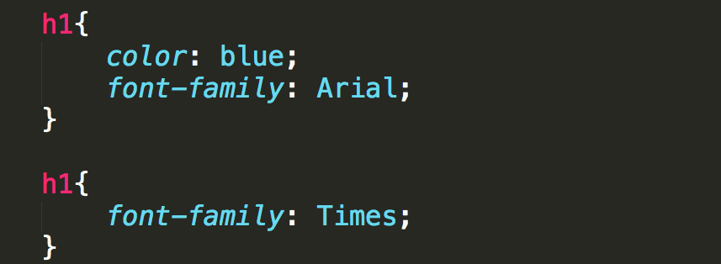
Rule precedence
What if one selector is defined in two external files?
The rules from the most recent file have precedence
What if one selector has more than one rule in the same file?
The most recent rule has precedence

Slide 11
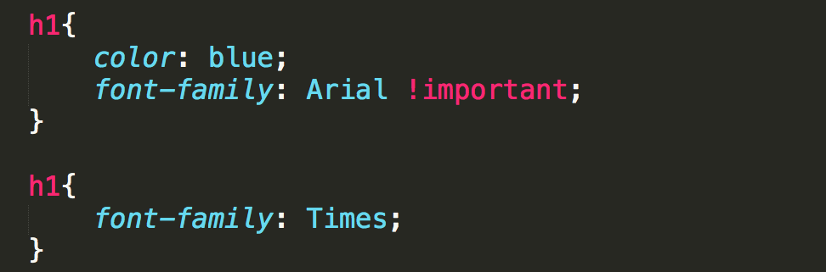
!important
It is possible to override later rules, use
!important

Slide 12
Example

Slide 13
Review
Why do we want/need to separate content from formatting?
How does this also tie in to external/internal style sheets?
Understand that this is very powerful. See http://www.csszengarden.com/

Slide 14

Acknowledgements/Contributions
These slides are Copyright 2015- Colleen van Lent as part of http://www.intro-webdesign.com/ and made available under a Creative Commons Attribution Non-Commercial 4.0 License. Please maintain this last slide in all copies of the document to comply with the attribution requirements of the license. If you make a change, feel free to add your name and organization to the list of contributors on this page as you republish the materials.
Initial Development: Colleen van Lent , University of Michigan School of Information

